Slide 1









WatchBot
Surveying on-site construction using robot or drone
Marzanah A. Jabar
(Prof. Madya Dr.)
Harith
Zainudin
Shakir
Asyraf
Iman Baharuddin
Muhd
Haris
Mahmoud Elmetwally
Mahmoud Said
A project by Ora Ora Group
Notes:
Assalamualaikum and good evening to all
We are Ora Ora group from Universiti Putra Malaysia, Malaysia
I am Muhammad Harith and this is my team.
this is our project…
WATCHBOT, SURVEYING ON SITE CONSTRUCTION USING ROBOT OR DRONE

Slide 2
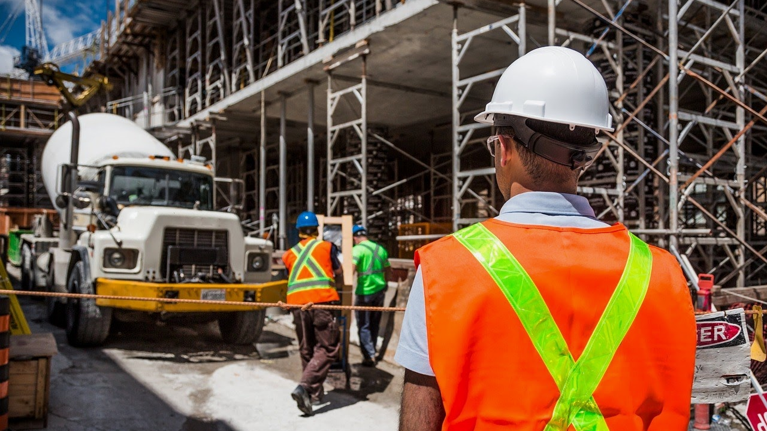
Topic 1:
Developing New and Secure Remote Work & Collaboration Solutions
Notes:
Hilti is constantly developing innovative ways to allow our users to communicate effectively with each other better, which in turn, will assist in generating additional business values not only between our own team members, but also to our customers. Our customers are located all around the world and due to this multi-location nature of the business, it is important that the proposed solution is easy to use, reliable, and secure.
Our task: Design and develop new and secure solutions that promote effective and efficient communication for the intended users including our own team members and/or the customers. The solutions must be robust with regards to security and data protection.

Slide 3
Problem
problem #1
Lack of real time supervising method when construction is in progress
problem #2
The safeness of the workers at the construction sites
Problem #3
Limited communication from different time zones and locations
Notes:
Before we go further into our presentation, I think it is proper for me to show you what is the problem that we have identified making us come out with the idea of watchbot

Slide 4
FACTS
150, 000 construction site accident injuries each year
47% of fatal work injuries are related to construction workers
5,333 workers died on the job in 2019
Notes:
Let me tell you the FACTS that related to construction sites accidents
This is some shocking construction site accident statistics according to Keller & Keller (Keller & Keller is a multi-state personal injury firm in US)
There are roughly 150,000 construction site accident injuries each year according to the US Bureau of Labor Statistics
47% of fatal work injuries are related to construction workers
5,333 workers died on the job in 2019 [https://www.bls.gov/news.release/cfoi.nr0.htm] (3.5 per 100,000 full-time equivalent workers) — on average, more than 100 a week or about 15 deaths every day.

Slide 5
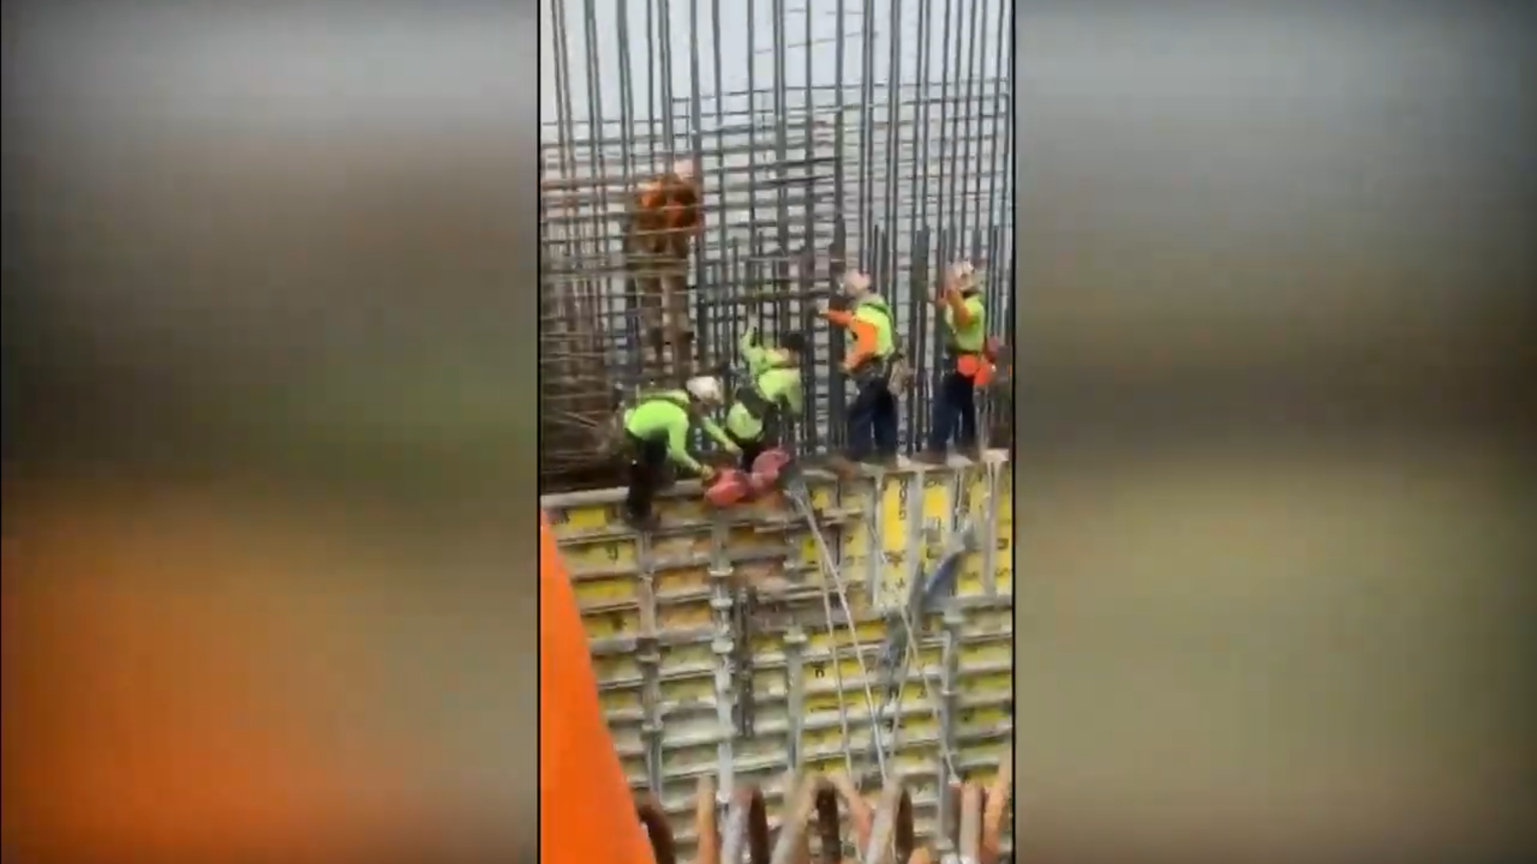
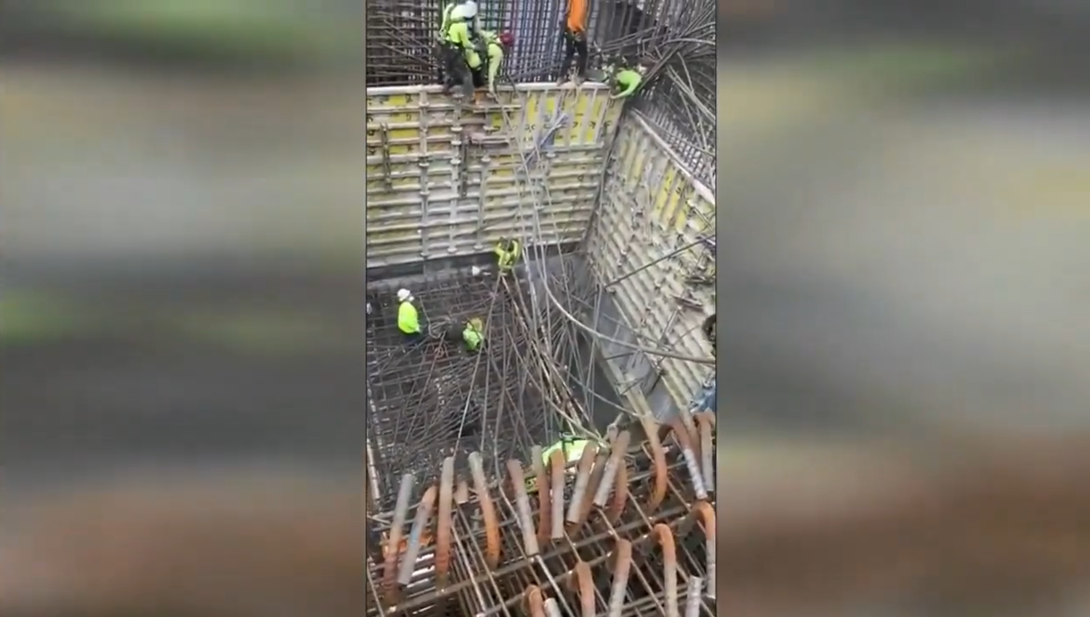
Case study
Notes:
According to this picture, we can see a horrific scene based on our searching. At the construction site
Picture 1
-one worker leg painfully trap by the wall
Picture 2
-because of the imbalance of the steel rod, suddenly another man, has been piling up by steel rod
2 accidents at one construction site
one of them placed in ventilator (machine that helps you breathe or breathes for you)
This is not what we want, as life is important and valuable for all people.
That person may need to cut his leg, as the leg has been stuck by a heavy wall. Imagine, if that wall hit your leg, and you’re the one in your family that are working. You are using your leg to move, to do work, and to get money for your family. And because of that incident, you cannot work anymore as it will be hard for you to move and do work. We do not want to happened right?

Slide 6
WHY THIS SOLUTION?
For real-time surveillance
To increase safety in construction site
For ease of use of the robot for the engineer
Notes:
So, WHAT to EXPECT from our project? , SIGNIFICANCE OF OUR PRODUCT? And why watchbot is a solution
real time surveillance
increase safety in construction site
ease of use of the robot for the engineer
Of course we want to solve the problem that has been stated.
Firstly.. with implementing watchbot, we expect that construction site safety can be increased. With the use of machine learning that my friends will explain after this.
We also expect that, this watchbot can increase the communication so that engineer, workers and developers can communicate efficiently

Slide 7


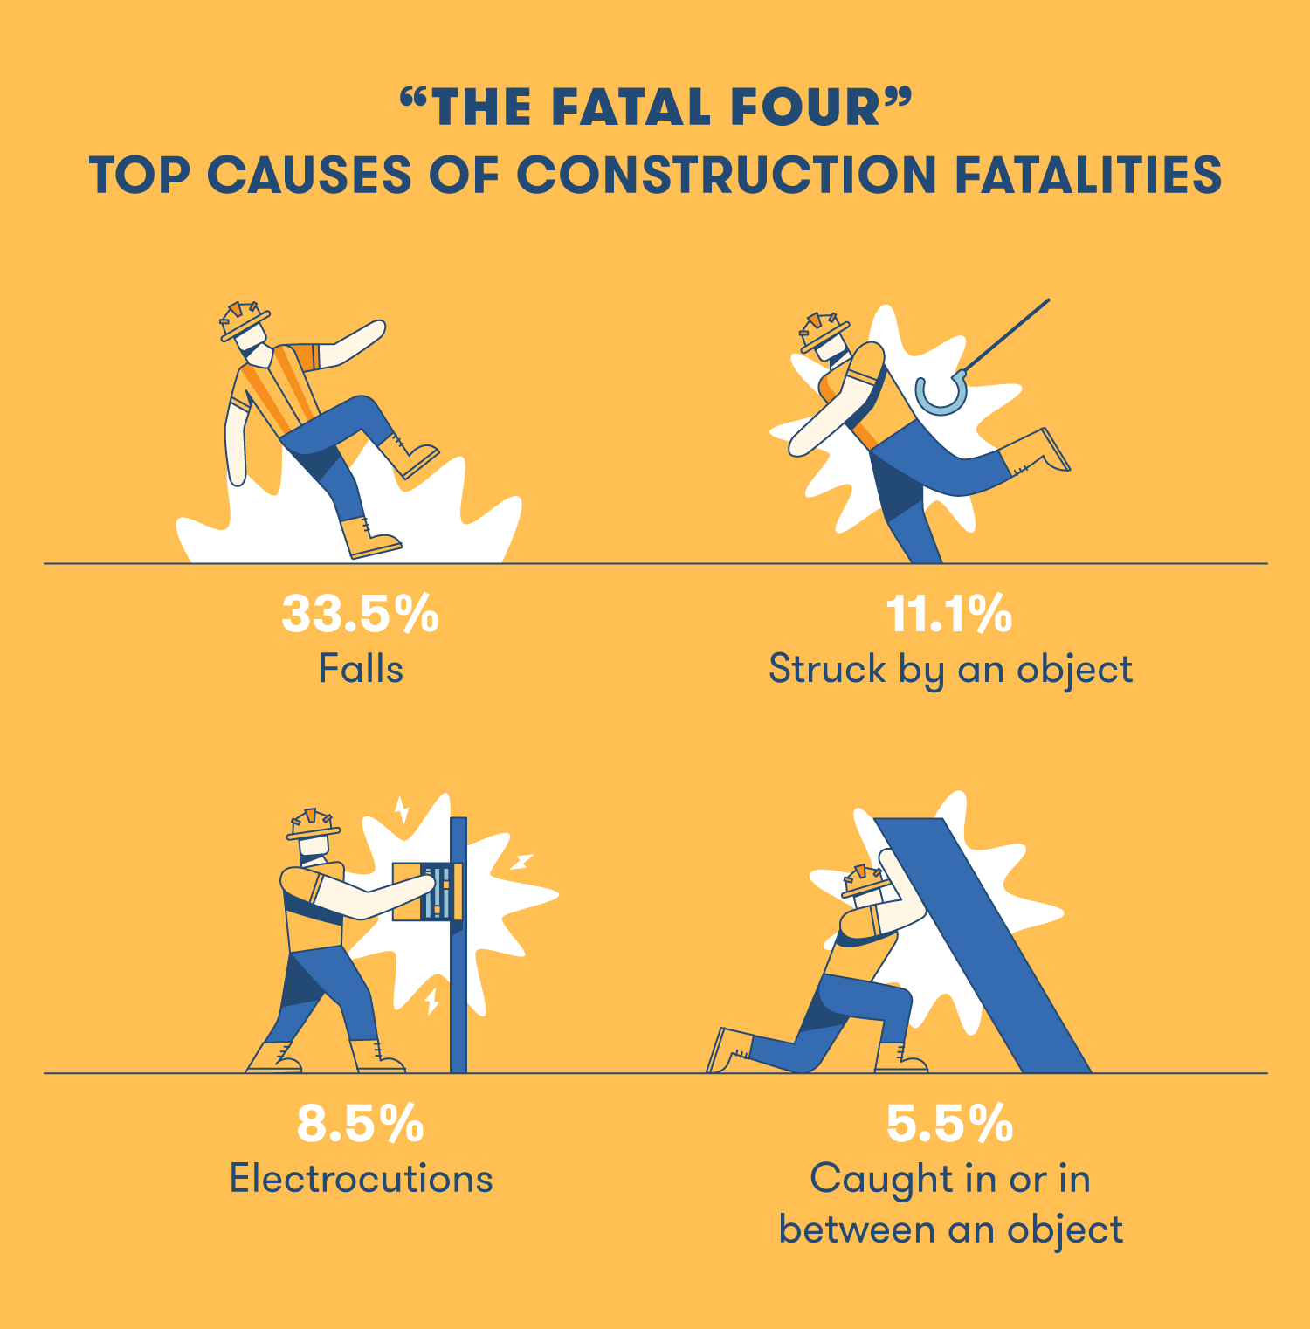
Idea
Creating a safer environment and also tracking the progress of the construction site using drone or robot on site that utilize Light Detection and Ranging (LIDAR)

Slide 8
What if this system go live?
Drone/robot operator supervise in real time.
Assess and do regular check up on building.
Reduce the risk of fatal casualties.
Notes:
The drone or the robot operator can monitor what happened at the construction site in realtime.
This bring us to the next point which is with the use of this system, they can fly the drone or control the robot remotely. the engineer can utilize the LIDAR function to generate 3D mapping of the building. This makes them easier to have an overall look at the building but at the same time, can supervise in real time. Without actually being there, therefore the engineer can control the drone/robot remotely allowing them to save time and improve efficiency in conducting regular check up.
For the last point, when this system go live, we hope and expect to reduce the reliance on direct human involvement when conducting an inspection and surveillance, therefore reducing the risk of fatal casualties. As we all know, the top causes and the higher percentage of construction fatalities involve falling from higher place which is around 34%. If there are human involvement during the inspection, the engineers can use the drone or robot to detect worker who are not wearing or lack of safety equipment. This is because, when employees work at a higher place, they need a proper safety equipment. It is absolutely critical that the job is assessed and safety equipment is in place before the work begins like
Are safety nets in place?
Are harness provided?
Are holes covered?
So when they can detect this, they can notify them directly using the speaker.

Slide 9
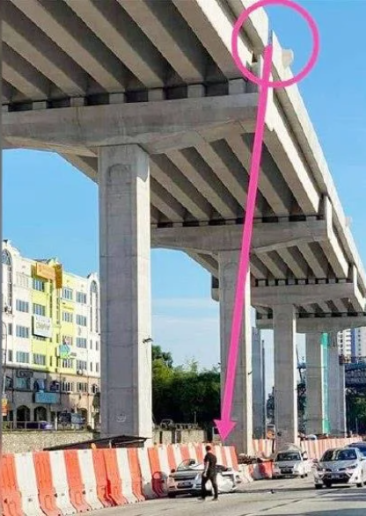

A car was hit by concrete stone from the highway construction due to worker negligence because not following proper work procedures.

Slide 10
The Benefits
Monitor situation in real time
Save time for the engineer to do regular checkup and assessment
Increase safety for workers
Notes:
For the benefir, watchbot can

Slide 11
The REQUIREMENTS

Slide 12
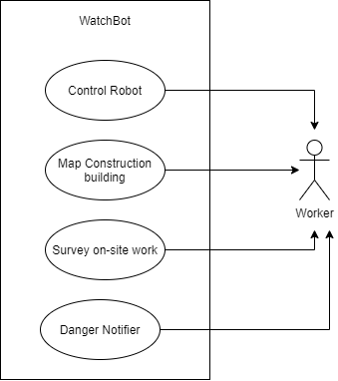
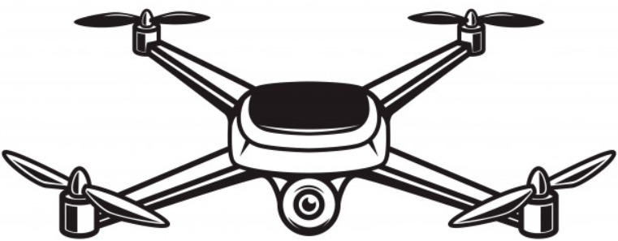
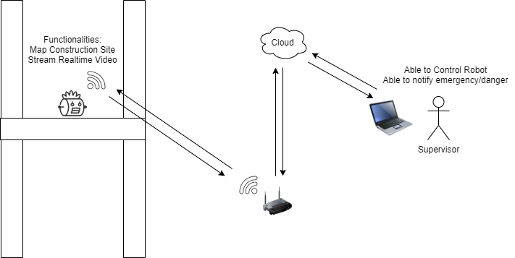
Use case diagram
*We expect an area of coverage up to 10km

Slide 13
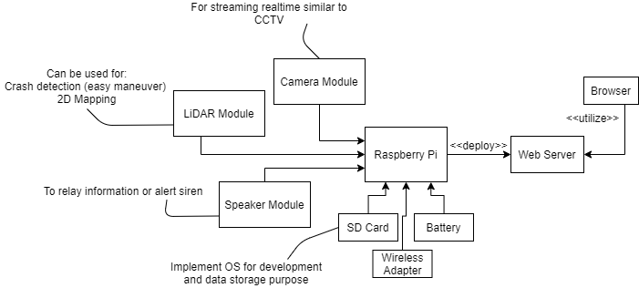
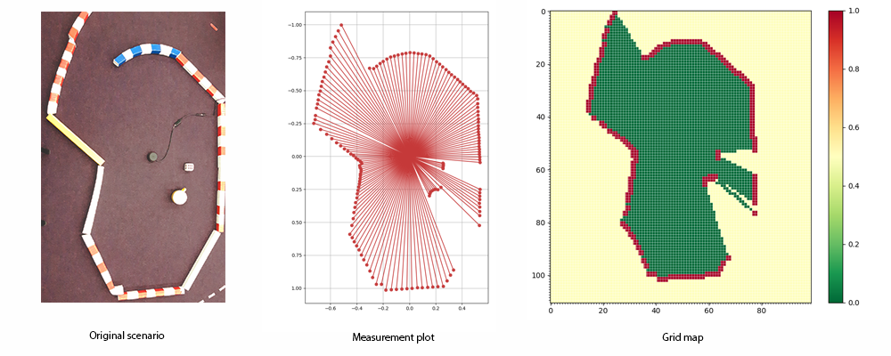
Architecture
How LiDAR Mapping Works

Slide 14
how this things works?
The robot will be either a drone/ground type robot which will have WiFi adapter. User can control the movement of the robot from a webpage deployed by the Raspberry Pi OS.
All sensor input will be streamed through the webpage and transform into more readable format such as graph, table or any visual iteration.
LiDAR and Camera is use for surveillance and construction mapping while speaker module used for any announcement or to relay any information if there is emergency.

Slide 15

Prototype
Notes:
Provide authentication and authorization. Secure connection.

Slide 16
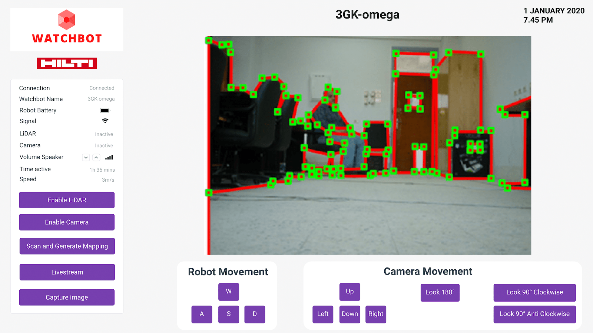
Prototype
Notes:
Controlling and Monitoring.
Providing Sensors information.
Object detection and tracking.

Slide 17
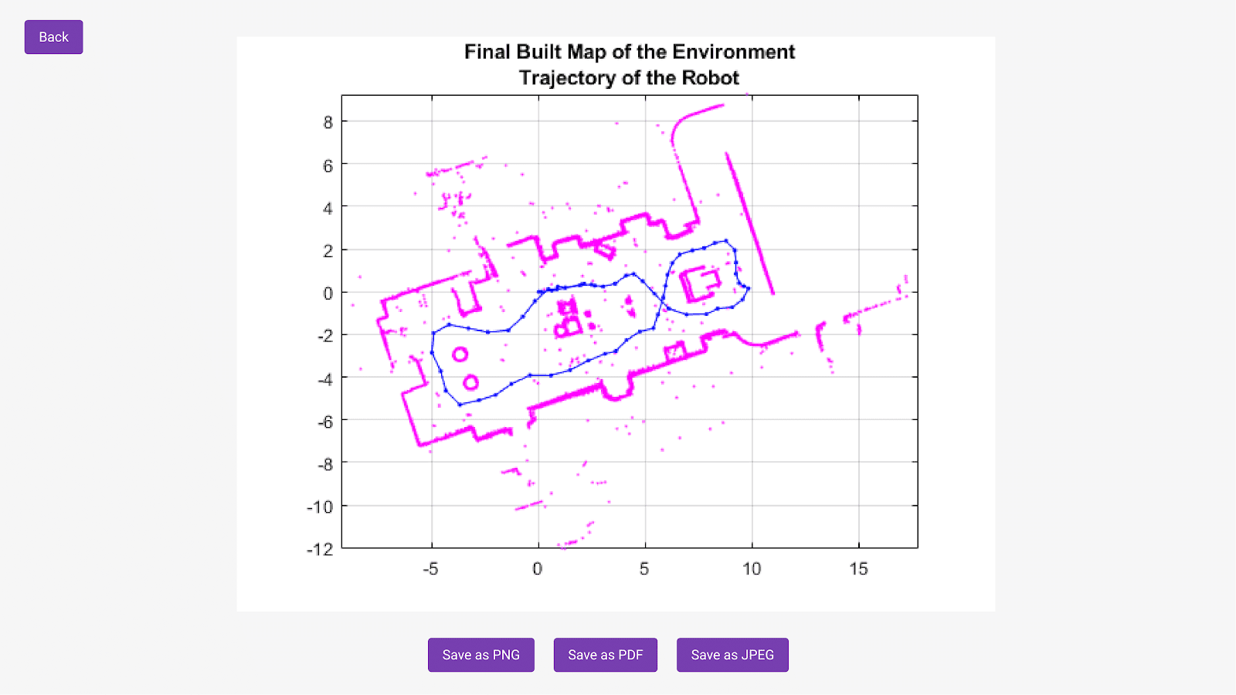
Prototype
Notes:
Use lidar sensor to update and track the progress of construction.

Slide 18
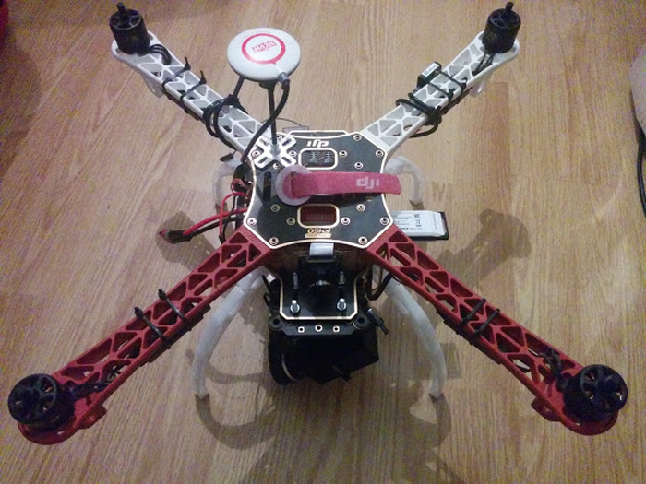
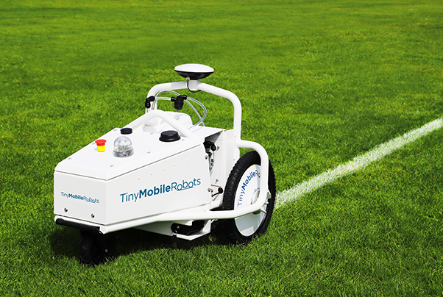
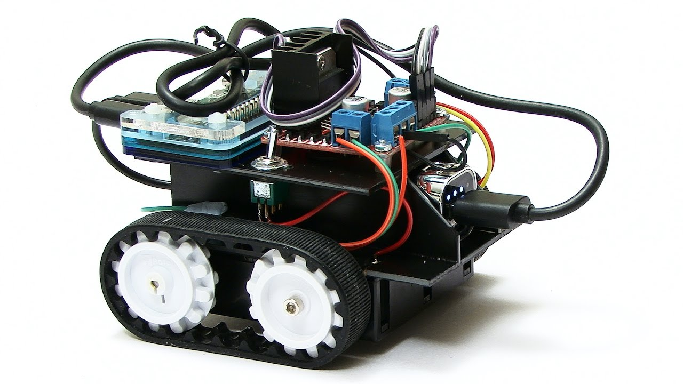
Competitive Analysis
TinyMobileRobots
WatchBot

Slide 19
Competitive Analysis
Available Surveying Robot on the Market
 | TinyMobileRobots | Watchbot
Offer Surveying Capabilities | Land and Road | Land,Air (Depends on the robot unit)
Able to Plot Map | Road and Land Marking Only | Building Wall and Floor Plan
Easily Integrate and Modifiable | No | Yes, Up to Raspberry Pi Capabilities
Able to convey information | No | Yes, through sound speaker
Notes:
TinyMobileRobots vs WatchBot
Surveylance from air
2D mapping on building wall and floorplan
Ease of Intergration with the use of RasberryPi and provides Modularity for future expansion.
Form of communication through speaker on our WatchBot

Slide 20
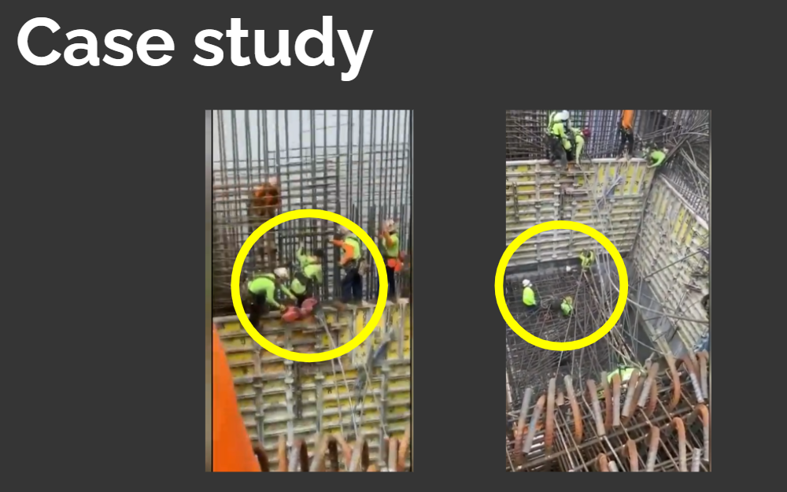
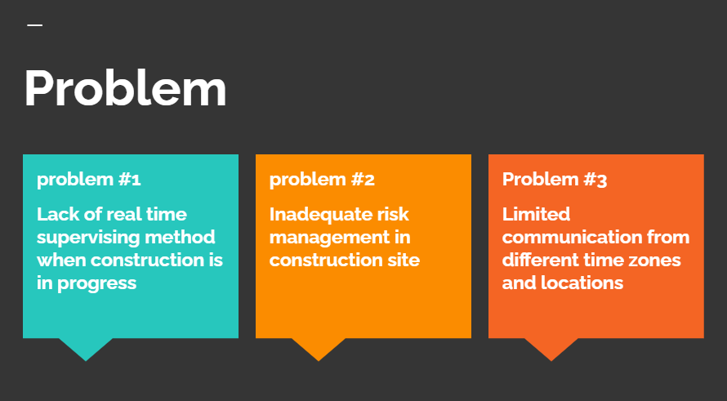
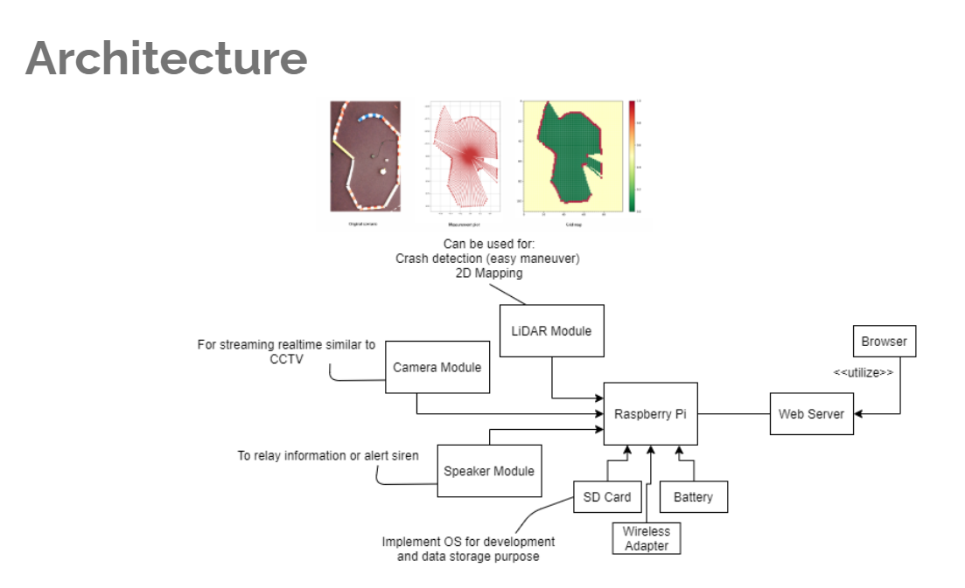
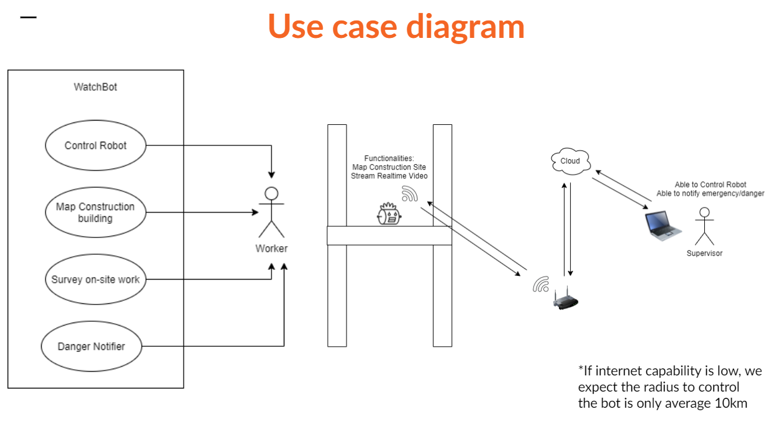
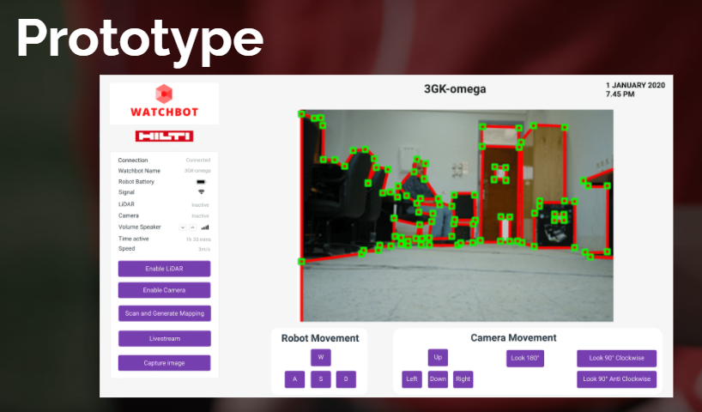
Conclusion
Notes:
Hope to tackle the problem of realtime monitoring and increase the safety standards of construction site

Slide 21
“Stay Safe & Awesome”

